Slide 1

DESIGN OF A SITE SELECTION SYSTEM FOR A LITHIUM PROCESSING PLANT IN ZIMBABWE
HIT300 – DESIGN AND MAKE PROJECT
TIVAKUDZE MAGUNDA – H240646A
Supervisor: Eng Gwatidzo
Industrial and Manufacturing Engineering

Slide 2
PROBLEM BACKGROUND
Lithium powers electric-vehicle and grid-storage batteries; global demand has grown sharply.
Zimbabwe banned unprocessed lithium exports in December 2022, committing the country to beneficiation.
Main sources are Bikita, Arcadia (Goromonzi) and Zulu (Insiza); a plant draws ore from several mines.
Infrastructure is uneven: rail, grid and water differ sharply between districts.
Hidden factors (water, power, tailings, community response) decide whether a plant succeeds.
Without a written method, factor weights shift with whoever is in the room.

Slide 3
LITERATURE REVIEW
Multi-criteria decision making: weighted scoring and AHP are mature but need a skilled analyst (Belton and Stewart, 2002).
GIS suitability analysis: strong for finding where a plant could go, weak at gates, costs and scenarios.
Facility location and transportation models: give cost-minimal allocation (Daskin, 2013; Eiselt and Marianov, 2011).
Feasibility gates: hard constraints that no score can compensate for.
Research gap: no tool joins gates, scoring, optimisation and reporting for lithium in Zimbabwe.
Second gap: existing methods assume an analyst; decision makers need inputs and outputs only.

Slide 4
PROBLEM STATEMENT
Zimbabwe has no structured, transparent and repeatable tool for selecting lithium processing plant sites.
Unstructured judgement hides trade-offs and inflates lifetime operating costs.
Utility, land and environmental risks show up only after construction begins.
The decision is once-off with a decades-long tail, so it must be right the first time.
“Right” means transparent, auditable and comprehensive, not merely confident.

Slide 5
AIM
To design a site selection system for a lithium processing plant in Zimbabwe that combines a structured criteria framework, a mathematical optimisation model and a user-facing computational tool to produce transparent and defensible site recommendations.

Slide 6
OBJECTIVES
1
Criteria framework
Define the industrial, logistical, utility, land and environmental factors, with the evidence required to assess each.
2
Optimisation model
Formulate a transparent model for facility selection and feedstock allocation with stated capacity, supply and feasibility constraints.
3
Computational system
Report feasibility-gate outcomes, estimated annual costs, allocation decisions and sensitivity to changing assumptions.

Slide 7
RESEARCH METHODOLOGY
Design-science approach: the artefact is a decision support system; every design choice is explicit and justified.
Problem identification
Criteria definition
Gate specification
Scoring and optimisation model
Software design and demonstration
Evaluation: demonstration on a worked scenario; outputs checked for correctness, completeness and explainability.
Data: criteria from siting literature adapted to Zimbabwe; site and mine data entered by the user; OpenStreetMap basemap.
Missing evidence: never defaulted; a site with no water data fails the water gate.

Slide 8
CONCEPT 1: DESKTOP GIS WEIGHTED OVERLAY
Prepare spatial layers
Weighted overlay in QGIS / ArcGIS
Analyst interprets suitability map
Manual write-up
Strength: excellent for regional screening and for discovering where a plant could go.
Weakness: no gate logic, no allocation optimisation and no repeatable interface; the analyst must rebuild the workflow for every new question.
REJECTED: fails gates, optimisation and interface requirements

Slide 9
CONCEPT 2: PYTHON, FLASK AND POSTGIS
Forms enter sites, mines, weights
Feasibility gates (Python)
Scoring + LP allocation (SciPy / PuLP)
Report on Flask pages
Strength: meets every mandatory requirement; PostGIS offers true spatial queries.
Weakness: two languages and two frameworks, plus a database server to install, secure and back up, for spatial needs that are only simple distances.
RUNNER-UP: passed screening, weighted score 66.5 / 100

Slide 10
CONCEPT 3: NEXT.JS, SQLITE AND OPENSTREETMAP
Next.js UI: sites, mines, weights
SQLite store via Prisma
Feasibility gates
Weighted score + allocation
Results, map, sensitivity
Strength: one language end to end, zero-administration database, free map tiles and an auditable pipeline.
Weakness: SQLite does not suit heavy concurrent use and the solver is home-built, which is acceptable at this problem size.
SELECTED: passed screening, weighted score 90.5 / 100

Slide 11
CONCEPT 4: MATLAB OR EXCEL AHP TOOL
Pairwise comparison matrices
Derive weights, check consistency
Weighted scores per site
Excel / MATLAB tables and charts
Strength: rigorous weight derivation with a built-in consistency check.
Weakness: files are fragile to share, anyone can edit logic silently, gates cannot be enforced and there is no scenario database or map.
REJECTED: fails gates and interface (AHP kept as future work)

Slide 12
CONCEPT 5: MACHINE LEARNING SCORING
Feature engineering per site
Train classifier on labelled sites
Predict suitability probability
Rank sites
Strength: scales to large, repetitive prediction tasks.
Weakness: no labelled dataset of good and bad sites, a black-box result cannot explain why a site won, and the problem is only a handful of candidates.
REJECTED: fails explainability and has no gate mechanism

Slide 13
CONCEPT SELECTION
Mandatory requirement | C1 | C2 | C3 | C4 | C5
Criteria framework with evidence | ✓ | ✓ | ✓ | ✓ | –
Feasibility gates | – | ✓ | ✓ | – | –
Allocation optimisation | – | ✓ | ✓ | ✓ | –
Usable decision-maker interface | – | ✓ | ✓ | – | –
Explainable output | ✓ | ✓ | ✓ | ✓ | –
Result | Fail | Pass | Pass | Fail | Fail
Criterion (weight) | C2 | C3
Deployment, maintenance (25%) | 60 | 90
Single language (20%) | 55 | 95
Persistence simplicity (20%) | 70 | 90
Mapping cost (15%) | 75 | 90
Auditability (20%) | 80 | 85
Weighted total | 66.5 | 90.5
Five mandatory requirements screened out Concepts 1, 4 and 5; one failure eliminates a concept.
Concept 3 wins on four of five criteria; Concept 2 would need to win every criterion outright to overturn it.

Slide 14
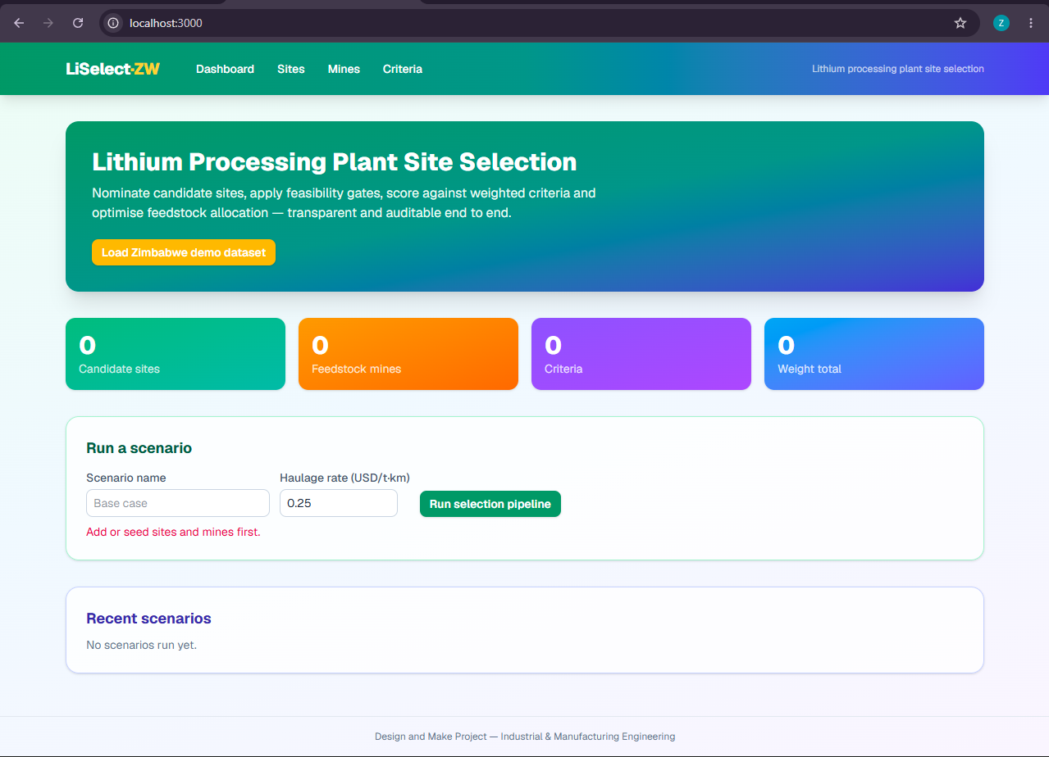
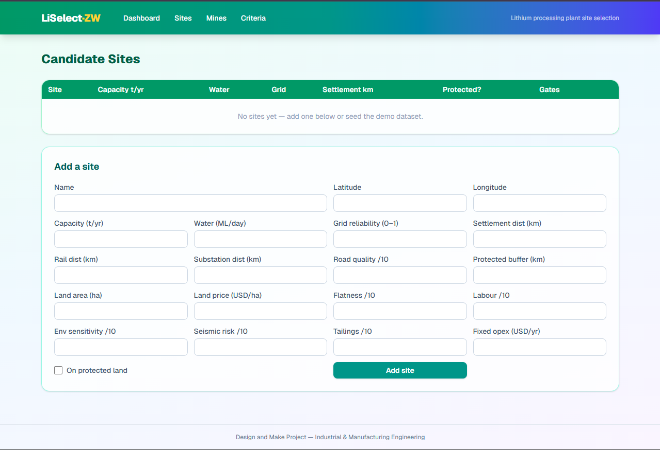
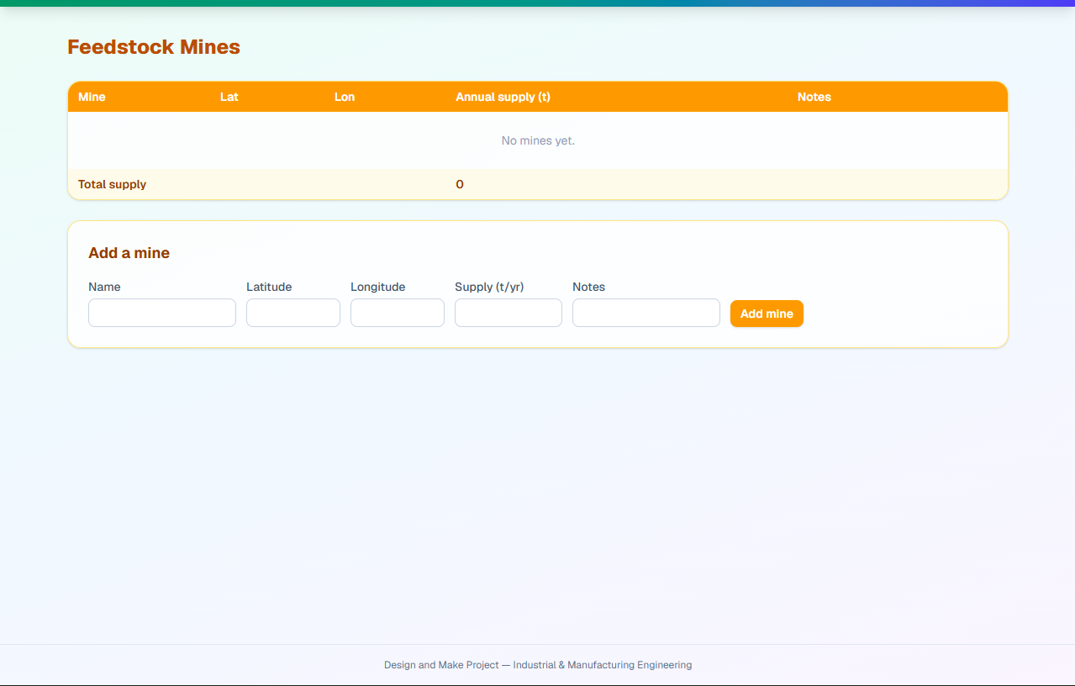
FINAL CONCEPT: LiSelect·ZW
Input sites, mines, weights
Feasibility gates
Weighted scoring
Cost-optimal selection + allocation
Sensitivity
Report and map
Stack: Next.js + TypeScript on the server, SQLite through Prisma, Leaflet with OpenStreetMap, Recharts.
Pages: Dashboard, Sites, Mines, Criteria and a saved Scenario report.
Principle: gates run first and a score can never compensate for a failed gate.
Traceability: every output number traces to an input, a gate, a weight or a constraint.

Slide 15
DESIGN CALCULATIONS: CRITERIA, GATES, SCORING
Gate | Pass if
Water supply | ≥ 4 ML/day
Grid reliability | ≥ 0.70
Settlement buffer | ≥ 3 km
Protected land | not on protected land
Plant capacity | ≥ 200,000 t/yr
Land area | ≥ 50 ha
Tailings suitability | ≥ 5 / 10
Feedstock supply | total supply ≥ capacity
15 criteria in 5 groups: Industrial, Logistical, Utility, Land, Environmental; each has a definition, evidence required and source.
Normalise: n = (v − min) / (max − min), clamped 0–1; cost criteria use 1 − n; scaled to 0–100.
Score: S = Σ(w·n) / Σw, so only relative weights matter.
Example: water 8 ML/day on range 0–10 gives n = 80.

Slide 16
DESIGN CALCULATIONS: OPTIMISATION MODEL
min Σj (Fj + Lj) yj + Σi Σj r · dij · xij
s.t. Σj yj = 1 one facility
Σj xij ≤ Si for all i mine supply
Σi xij = Cj · yj for all j plant capacity
yj = 0 if site j fails a gate feasibility
Variables: yj = 1 if site j is selected; xij = tonnes per year from mine i to site j.
Data: Si mine supply, Cj capacity, dij road km (straight line × 1.3), r haulage rate (USD/t·km), Fj fixed opex, Lj land price × area ÷ 20 years.
Solution: each gate-passing site is solved exactly, cheapest road-km first; the lowest total annual cost wins.

Slide 17
RESULTS: DEMONSTRATION DATASET
Illustrative Zimbabwe dataset: 5 candidate sites, 5 mines, 1.26 Mt/yr supply, haulage USD 0.25/t·km
Site | Gates | Reason / score
Goromonzi | PASS | Score 67.0 (rank 1)
Kwekwe South | PASS | Score 60.7 (rank 2)
Masvingo East | PASS | Score 56.3 (rank 3)
Insiza (Zulu adjacent) | FAIL | Water 2.8 ML/day; grid reliability 0.55
Mutorashanga Wetland Margin | FAIL | Settlement 1.2 km; protected land; tailings 3.5
Two of five sites are eliminated at the gates, and the failure reasons are recorded for stakeholders.
The three survivors are ranked by weighted score and then priced.

Slide 18
RESULTS: COST AND ALLOCATION
Mine | t/yr | Road km | Cost
Arcadia | 420,000 | 5 | $0.48M
Bikita | 30,000 | 366 | $2.75M
Total | 450,000 |  | $3.22M
Recommended: Goromonzi at USD 6.52M per year (haulage 3.22M + opex 3.20M + land 0.09M).
Next best: Masvingo East USD 24.75M and Kwekwe South USD 27.02M.
Allocation: nearest mine first, then the rest from the next mine up to its supply limit.
Haulage dominates: Goromonzi sits 5 km from Arcadia, the largest nearby supplier.

Slide 19
RESULTS: SENSITIVITY
Haulage rate | Annual cost | Change | Optimal site
USD 0.125 (0.5×) | $4.91M | −24.7% | Goromonzi
USD 0.200 (0.8×) | $5.87M | −9.9% | Goromonzi
USD 0.250 (base) | $6.52M | 0% | Goromonzi
USD 0.300 (1.2×) | $7.16M | +9.9% | Goromonzi
USD 0.500 (2×) | $9.74M | +49.5% | Goromonzi
Mine supply −15%: cost +87.4% (USD 12.2M); Goromonzi still optimal.
Mine supply +15%: cost −41.6% (USD 3.8M); Goromonzi still optimal.
Weights ±10%: no criterion changes the top-scoring site.
ROBUST: the recommendation holds under every tested perturbation
A fragile result is flagged FRAGILE with its reasons, so weak evidence is never hidden.

Slide 20
ECONOMIC ANALYSIS
Cost of a wrong site (demo data): Masvingo East costs USD 18.2M more per year than Goromonzi, about USD 365M over a 20-year plant life (undiscounted).
Where the money goes: at Goromonzi, haulage 49%, fixed opex 49%, land 1.4%; haulage distance is paid on every tonne for the life of the plant.
Land price is not the decider: land amortisation is under USD 0.1M per year at every feasible site.
Cost of the tool: licence cost USD 0; Next.js, SQLite, Prisma, Leaflet and OpenStreetMap are free and run on a single host.
Caveat: costs cover haulage, fixed opex and land only; capital cost and revenue are not modelled.

Slide 21
RECOMMENDATIONS
Connect real spatial datasets so protected-area and settlement checks come from geometry, not user assertion.
Add a formal AHP module so weights have a documented provenance.
Replace straight-line distances with routed road-network distances.
Extend allocation to several plants for regional planning.
Validate against real candidate sites and compare with practitioner judgement.
Make gate thresholds editable in the interface.

Slide 22
CONCLUSION
Objective 1: 15 criteria in 5 groups with definitions and required evidence, plus 8 feasibility gates.
Objective 2: a cost-minimising facility selection and allocation model with capacity, supply and gate constraints.
Objective 3: a web system reporting gate outcomes, annual costs, allocation and sensitivity with a robust or fragile verdict.
Result: repeatable, explainable and defensible site recommendations.
THANK YOU

